Slide 1
Capstone Project
AirBnB Hotel Analysis
BY- KASHFUR RAHMAN KHAN

Slide 2
Content
IMPORTING Libraries
Dataset Summary
Cleaning Data
Handling missing Data
Top 10 Most Reviewed Host
Top Highest price Host
Host Which Need To Update The Price
Estimating Revenue
Busiest months for renters
Types of Rooms
Room Availability

Slide 3
Libraries
Libraries used in this is Pandas, Numpy , Seaborn , Matplotlib

Slide 4
DATASET
Dataset airbnb_df has 48895 rows and 13 columns
id
host_id
name
host_name
neighbourhood
room_type
price
minimum_nights
number_of_reviews
reviews_per_month
last_review
calculated_host_listings_count
availability_365

Slide 5
Cleaning Dataset & Handling missing Data
Dropping all nan values using dropna() in airbnb_no_null_df .
Filling nan value with fillna().
Checking if there is any null value with info()
Converting date using pd.to_datetime
Converting nan value in Year and Month To 0 using pd.isnull

Slide 6
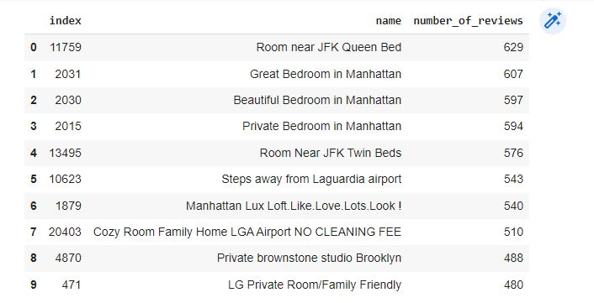
Top 10 Most Reviewed Host
USING COLUMNS =['name','number_of_reviews']
SORTING VALUES IN DESCENDING FORM

Slide 7
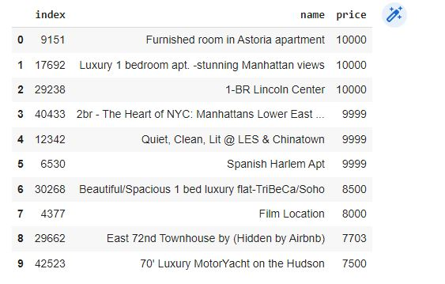
Top Highest price Host
USING COLUMNS=['name','price']
SORTING VALUES BY PRICE IN DESCENDING FORM

Slide 8
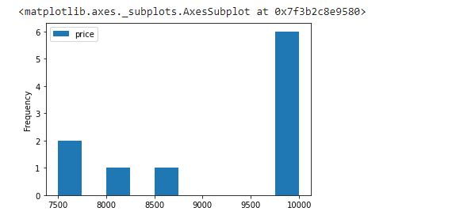

Slide 9
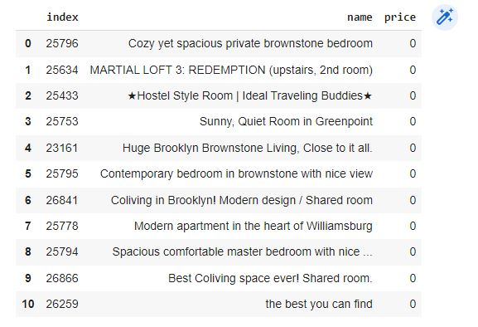
Host Which Need To Update The Price
Using dataframe price_df
Sorting values by price in ascending order

Slide 10
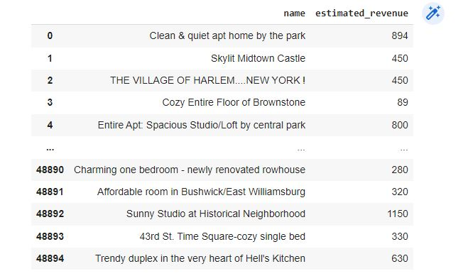
Estimating Revenue
Creating new column estimated_revenue
Multiplying price , minimum_nights , calculated_host_listings
Grouping the column estimated revenue with column name

Slide 11
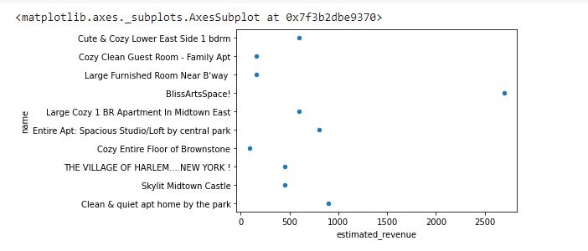

Slide 12
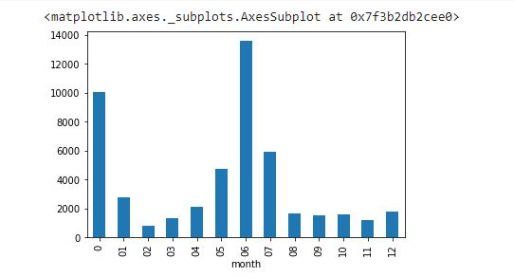
Busiest months for renters
Grouping year with month column using groupby and counting month

Slide 13
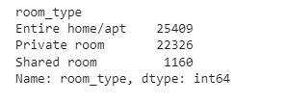
Room Types
Finding room types from column room_types using method unique()

Slide 14
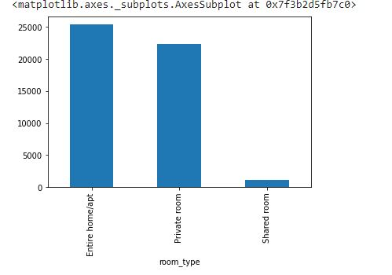

Slide 15
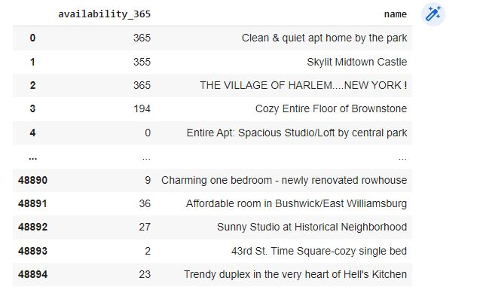
AVAILABLITY OF ROOMS
Using Column 'availability_365','name'

Slide 16
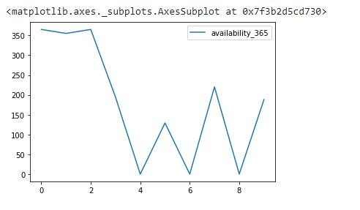

Slide 17
CONCLUSION
This information can help hosts and guests make informed decisions and optimize their experiences. Understanding the key factors that drive demand, such as seasonality and location, can help hosts set competitive prices and increase their chances of attracting guests. Analyzing the review scores and feedback provided by guests can also provide valuable information for improving the quality of the properties and the overall experience for guests. Overall, Airbnb data analysis can play a crucial role in driving success for both hosts and guests on the platform.

